Slide 1

Predicting Stock Trend based on Social Media Articles
Group-8
Prriyamvradha Parthasarathi
Sri Sravya Perala
Sai Manikanta Anumalasetty
Alina Adhikari
Chaitanya Kommineni

Slide 2
Description of the use case
Objective: Predict future stock trends by analyzing sentiment in social media discourse.
Dataset comprises social media articles tied to various stocks.
Each article is tagged with a stock ticker symbol and sentiment polarity.
Sentiment polarity indicates whether sentiment expressed is positive, negative, or neutral.
Natural Language Processing (NLP) techniques will be employed for sentiment analysis.

Slide 3
Proposed Model
Data Collection
Pre-processing the data
Classification
Stock Data
prediction
Output

Slide 4
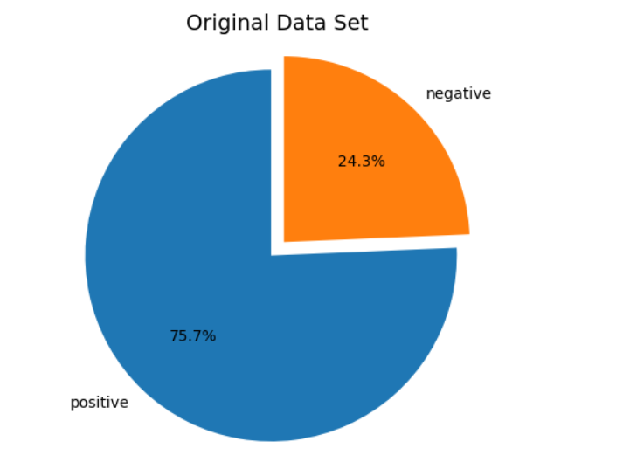
Methodology
1. Dataset used: Publicly available tweets on Tesla Inc, collected from January 1,2019 to July 14, 2019.
2. Tesla Stock Data Obtained from Yahoo Finance

Slide 5
Methodology
2. Data Preparation/Data cleaning:
Tokenization: tweets are converted into word tokens using nltk function.
Normalization: tags like http, email, numbers, currency symbols are removed, helps in simplifying the text and improving the efficiency of subsequent processing steps.
Removing stop words: Removing stop words helps in reducing noise in the text and focusing on the more meaningful content.
Stemming and Lemmatization: By reducing words to their base forms, stemming and lemmatization help in standardizing the vocabulary and consolidating similar words.

Slide 6
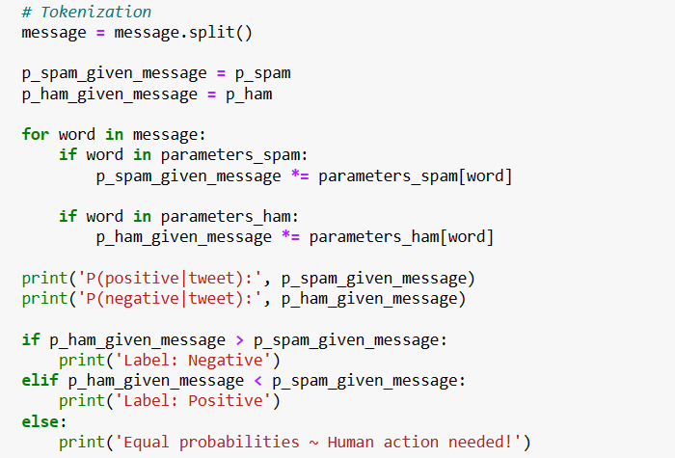
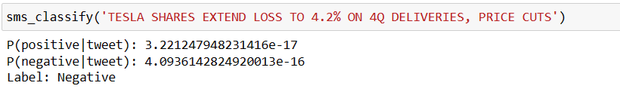
Sentiment Classification
• Sentiment analysis classification involves categorizing tweet data into predefined sentiment classes, such as positive, negative, to understand the emotional tone of the content.
• This implements the Naive Bayes algorithm for text classification by calculating class probabilities from word frequencies, applying Laplace smoothing, and using Bayes' theorem to predict the sentiment (positive/negative) of a new message.

Slide 7
Methodology
3.Model Learning and Prediction
Naïve Bayes classifer: It was used to classify tweets, and the model was able to classify the tweets with 89.8% accuracy.
Logistic Regression: Used logistic regression which was able to classify the tweets with 84.25% accuracy.
Gradient Boost: Classification with 81.6% accuracy
Adaboost: Classification with 83.75% accuracy.
Notes:
Naive Bayes: We used a Naive Bayes algorithm to classify tweets. This algorithm is simple and efficient and is useful for classifying text data as it assumes that the occurrence of each word in a tweet is independent of the occurrence of other words, which simplifies the calculations.
Logistic Regression: We used a logistic regression algorithm to classify tweets as the algorithm was able to analyse the content of tweets and assign them to different categories based on the text. We used a set of labelled tweets to train the algorithm and then used it to classify new tweets.
AdaBoost: We used a gradient boosting algorithm as this approach combines multiple weak learners to create a strong model that can accurately classify tweets into positive and negative categories. It is an effective way to classify text data as it can learn from past mistakes and quickly identify important features.
Gradient boosting sequentially adds models to correct errors of previous ones, popular for its versatility in regression and classification tasks with algorithms like XGBoost and LightGBM.

Slide 8
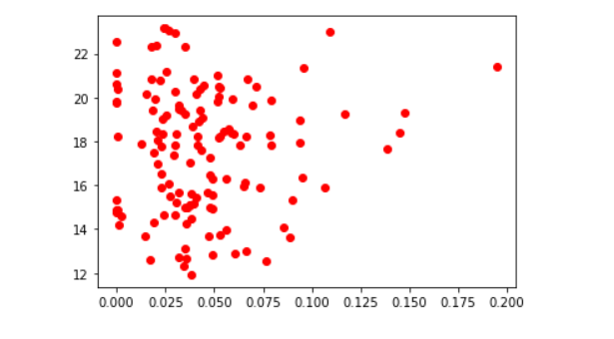
4. Testing and prediction:
The approach involved averaging sentiment across all tweets daily.
This average sentiment was then used to predict stock trend changes.
Hypothesis: Stock price percent change correlates with average sentiment.
Expected outcome: Increasing sentiment leads to higher stock prices, and vice versa.
Perfect correlation would result in a straight diagonal line.
Calculated correlation coefficient approximately 0.3.
Conclusion: Stock prices show some correlation with sentiment, albeit not highly significant.
Sentiment probabilities cannot be completely disregarded in stock trend analysis.
Overall, findings suggest a nuanced relationship between sentiment and stock prices.
Correlation between tweets sentiments and stock’s closing price
Notes:
To accomplish this, we take the average sentiment across all the tweets for each day and used the average sentiment to predict the change in stock trend. Therefore, if our hypothesis is correct, we would see the percent change in stock prices increase as the average sentiment increases and vice versa

Slide 9
Conclusion and Future Investigation
Our analysis, while insightful, overlooks factors such as the dataset's focus on English-speaking Twitter users, potentially limiting its relevance to broader public sentiment.
A broader study incorporating diverse sources of sentiment data could provide a more robust understanding of the correlation between sentiment and stock trends.
While speculation exists regarding the influence of mood on investment decisions, the direct correlation between stock investors and frequent Twitter users remains uncertain.
Future research should explore these areas further to deepen our understanding of the relationship between sentiment and stock market dynamics.
Notes:
Finally, Our analysis does not take into account many factors, such as the lack of relation to the real public sentiment due to the dataset only considering those who use Twitter and
speak English. It is possible to observe a higher correlation if the actual mood is studied. It can be speculated that people’s moods indeed affect their investment decisions, thus leading
to a correlation.

